Slide 1
Harry Potter Themed
It activities

Slide 2
The Digital Sorting Hat (Micro:bit / Python Programming)
  Students write or tweak a simple script to turn a BBC micro:bit (or an on-screen Python emulator) into the Sorting Hat.
  The Activity: Students use basic conditional logic (if/elif/else). When they press a button or shake the micro:bit, the device randomly selects and displays a Hogwarts House logo or text (e.g., "G", "S", "H", "R") on the LED matrix, accompanied by a custom retro beep sound.
  Why it works for Open Days: It teaches core programming concepts like randomization and variables in just a few lines of code. It gives visiting families an instant, tactile reward they can see and hear.

Slide 3
2. Marauder’s Map Cyber Security Challenge (Cryptography)
Turn your IT suite into a mini-Bletchley Park where students must decrypt clues to unlock a hidden "magical" directory on the network or a locked box. [1]
The Activity: Provide students with a "parchment" containing encrypted text (using simple ciphers like the Caesar Cipher or Pigpen Cipher). They must use an on-screen Python decoder tool or a quick spreadsheet formula to crack the codes. The decoded answers reveal the passwords to "reveal" the hidden map.
Why it works for Open Days: It introduces data security, encryption, and computational thinking without requiring prior coding knowledge. It is highly competitive and appeals to parents and students alike.

Slide 4
3. Diagon Alley Web Design & Ollivanders' Wand Selector (HTML/JS)
Students interact with a pre-made web page for a wizarding shop and learn how code changes the front-end user experience.
The Activity: Set up a basic web form where users enter their traits (e.g., flexibility, core preference, birth month). Students look at a simplified code editor to change the CSS styles (e.g., changing the background to house colors) or tweak a JavaScript function so the web page calculates and displays their perfect wand.
Why it works for Open Days: It offers an immediate visual payoff. It shows how the languages of the web (HTML, CSS, and JavaScript) build the sites they use every day.

Slide 5
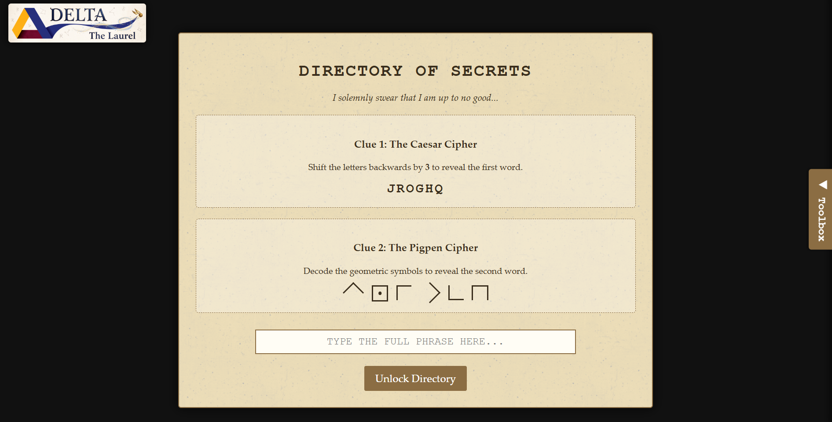

Slide 6
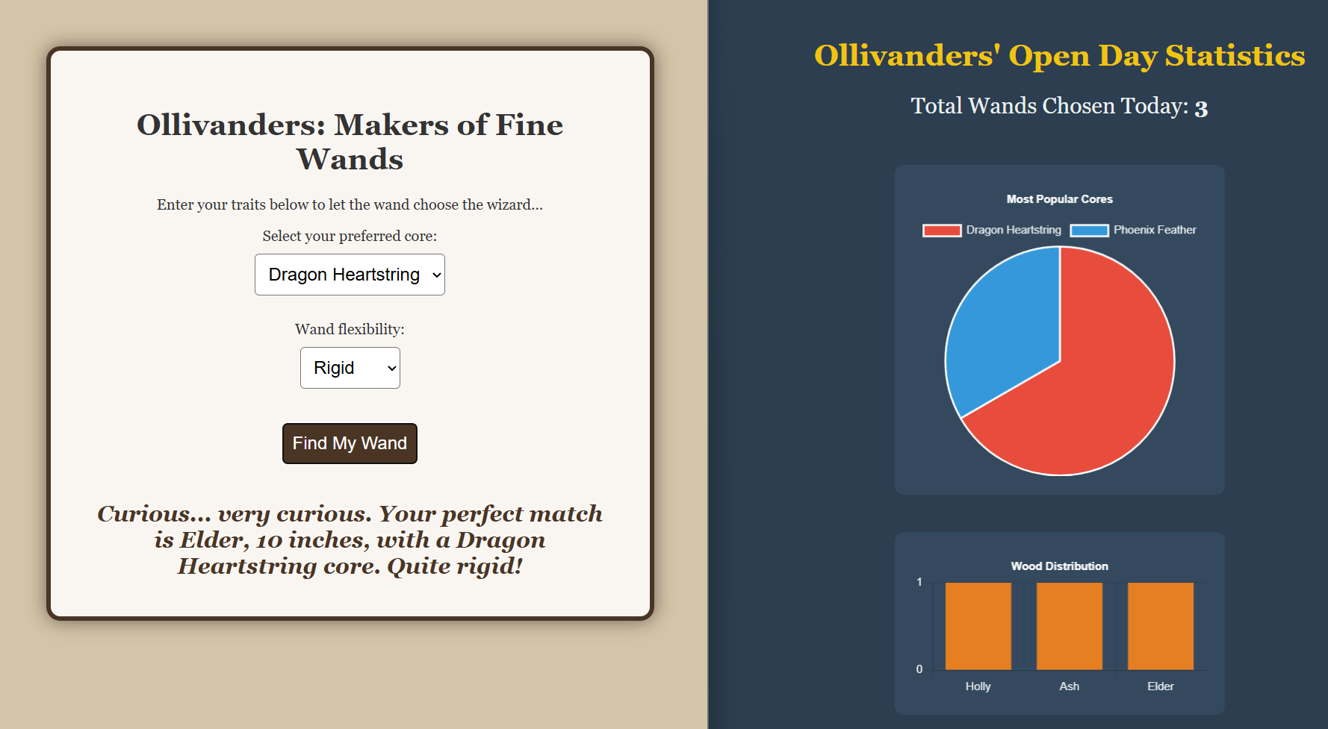
Page and Dashboard

Slide 7
4. Flitwick’s Flight Class (Scratch Block Coding)
A quick game-design station where visiting students debug or complete a mini-game.
The Activity: Provide a pre-built Scratch template of a character on a broomstick trying to catch a Golden Snitch while dodging Bludgers. The game is intentionally broken or missing core code (e.g., the broom doesn't move up, or the Snitch doesn't grant points). Students must drag and drop the missing blocks into place to fix the game and play it.
Why it works for Open Days: Scratch is exceptionally intuitive for younger students transitioning from primary school. A leaderboard on the whiteboard for the highest game score keeps the room buzzing.

